Slide 1

Payer User Group
Webinar – 7/31/2014

Slide 2
Agenda
Welcome (5 minutes)
  Opening Comments/ Review
  Meeting Goals
Chapter 243 Changes (25 minutes)
  Clarification of Requirements for Specific Elements
  Payer Q & A
  Validation Updates (5 minutes)
  Overview
  Implementation Timeline (10 minutes)
  Overview
  Testing
  Payer Q & A
  Other Updates and Reminders (10 minutes)
  File Locking
  File Naming
  Exemption Date Range
  Wrap-up (5 minutes)
  Additional Q & A

Slide 3
Meeting Goals
Review Changes in Chapter 243
Review Implementation Timeline
Answer Payer Questions About Changes
Review Other Updates and Reminders

Slide 4
Chapter 243 Review
Clarification of Requirements for Specific Elements
  Service Facility Location Information
    Definition and Clarification
    How to Populate These Fields
  Continued Use of ICD-9 Fields
    MC039-MC053 and MC058
    Until implementation of ICD-10
  How to Treat Placeholders for Retired (MC033-MC035) and Blank Fields (MC200-MC326)
    Include asterisks with no space in between “**”
    Example: …*MC032data****MC036data*…

Slide 5
Validation Updates
No validation changes to Member Eligibility or Dental Claims files
Summary Changes
  Validations have been dropped for retired elements
  Validations have been added for new elements
  No validations for ICD10 Fields until Enacted in 2015

Slide 6
Implementation Timeline
Task | Start Date | End Date
Adoption of Rule | 5/27/2014 | 5/27/2014
Notify Payers of Validation Revisions as a Result of Chapter 243 Changes | 7/31/2014 | 7/31/2014
Sample File Layout Disseminated to Payers | 8/15/2014 | 8/15/2014
Test Portal Open for Payer Testing of New Chapter 243 Format and Validations in Designated Test Environment | 9/1/2014 | 9/30/2014
Production Portal Open - New Chapter 243 Format and Validations | 11/5/2014 | 11/5/2014
Submissions of New Chapter 243 Format Files (October 2014 data) | 11/6/2014 | 11/30/2014

Slide 7
Testing the Changes to Chapter 243
We encourage all payers to participate in testing
Submit any period of data in the new format
Claims data submitted to the test environment will NOT be moved to the data warehouse

Slide 8
Payer Q&A
Question: Do we have an updated FAQ on the portal? Any other updated resource documents that we can refer to?
Answer: HSRI has maintained the FAQ in Portal. It should be updated with the latest questions and answers. Information about the changes to Chapter 243 can be found on the MHDO website.
Question: Is there a sample file layout available on the portal?
Answer: A sample file layout for the revised Chapter 243 requirements will be distributed on 8/15/2014 and posted in the Resource section of the Portal

Slide 9
Other Updates and Reminders
Locked Submission Period
Current Process
  Submission periods are locked for data already released to end users (data are released every quarter).
  When submitters try to submit data for a locked period, a validation is triggered. Currently to resolve this issue, it is a manual process.
  New Process
  Starting 8/7/2014 the system will collect information about why missing, supplemental or replacement data for a locked period is being submitted.
  The system will determine if your file is a an initial submission, replacement submission, or supplemental submission based on the file naming.
  If the data are less than a year old, the validation issue will be cleared as soon as the information is provided by the user.
  Submissions of data older than one year will require approval from MHDO before the issue will be cleared.

Slide 10
File Naming
  Payer ID: The Payer ID should correspond to the Payer ID in the header of the file.
  An underscore symbol: “_”
  Period ending date expressed as CCYYMM (four-digit calendar year and two-digit month; for example, 201403 indicates a March 2014 end date). Quarterly data submissions should use the end date for the last month of the quarter. For example, the first quarter of 2014 would use 201403.
  File type: Member Eligibility (ME), Medical Claims (MC), Dental Claims (DC), Pharmacy Claims (PC).
  Sequence number: This is used to differentiate files with otherwise identical file names (for example, when two medical files are submitted during the same submission period). The sequence number should be used to identify supplemental files. It’s expressed as a two-digit number, starting with 01. You must include the leading zero. The sequence numbering starts over with each new submission period.
  Version number: This is used to differentiate multiple submissions of the same file. The version number should be used to identify replacement files. This will be important if a file needs to be resubmitted to resolve an issue such as a validation failure. The letter v should be used, followed by two digits, starting with v01. You must include the leading zero. Original submissions of all files should be labeled v01. The Portal will not accept files that have the same name as an existing file.
  File extension (.zip, .7z, etc.)

Slide 11
File Naming Examples
  Period ending in January 2013. One dental file with no resubmissions or supplemental files:
    T0757_201301DC01v01.txt
  Period ending in January 2013. One pharmacy file with no resubmissions or supplemental files:
    T0750_201301PC01v01.txt
  Period ending in December 2012. One eligibility file and one replacement of the same file:
    C0756_201212ME01v01.txt
    C0756_201212ME01v02.txt
  Period ending in December 2012. Two medical files, the second is a supplemental file:
    C0756A_201212MC01v01.txt
    C0756A_201212MC02v01.txt

Slide 12
Exemption Request - Date Range
  The date range in the exemption request form now covers the data date, not the submission date.
  If the correct date range is not requested, your files may remain in a failed status.
  For example, when an exemption request for a January MC file submitted in February is requested, a start date of January must be selected. If February is selected, then exemption will not be activated until February’s MC file is submitted.

Slide 13
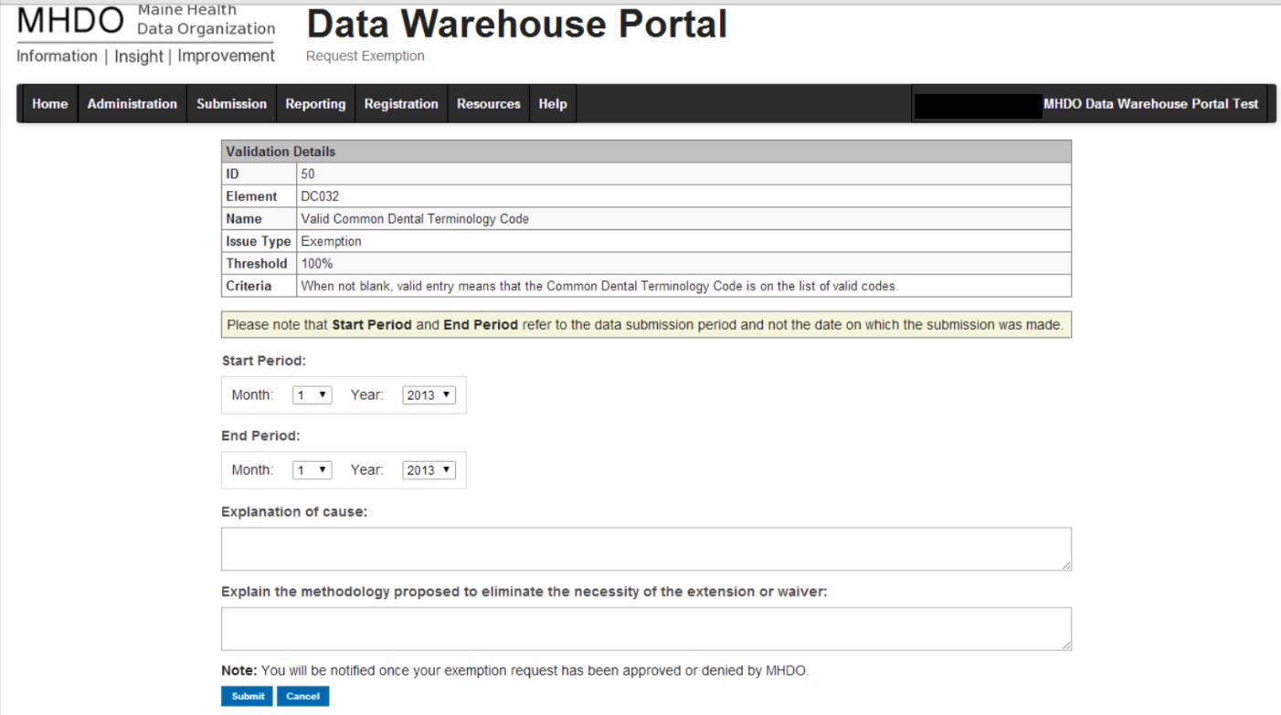
Exemption Request - Date Range

Slide 14

Questions? mhdo.maine.gov or
Philippe Bonneau Philippe.Bonneau@maine.gov
(207) 287-6743

